Slide 1
Scams of New York City Detecting (possibly) bogus listings with duplicate image detection
Resolution Hackathon (01.09.2015)
Team Deja Vu
Kevin Yau
Andrew Watkins

Slide 2
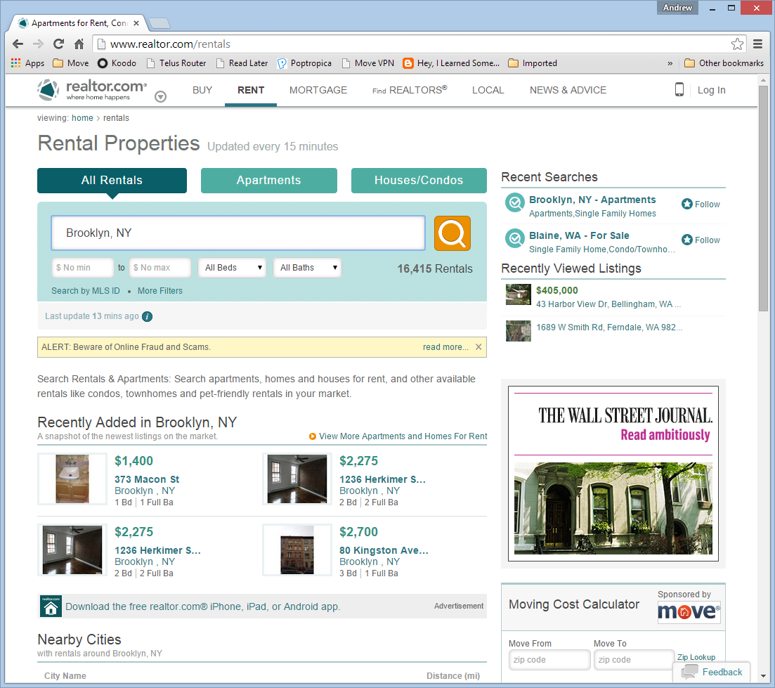

Slide 3
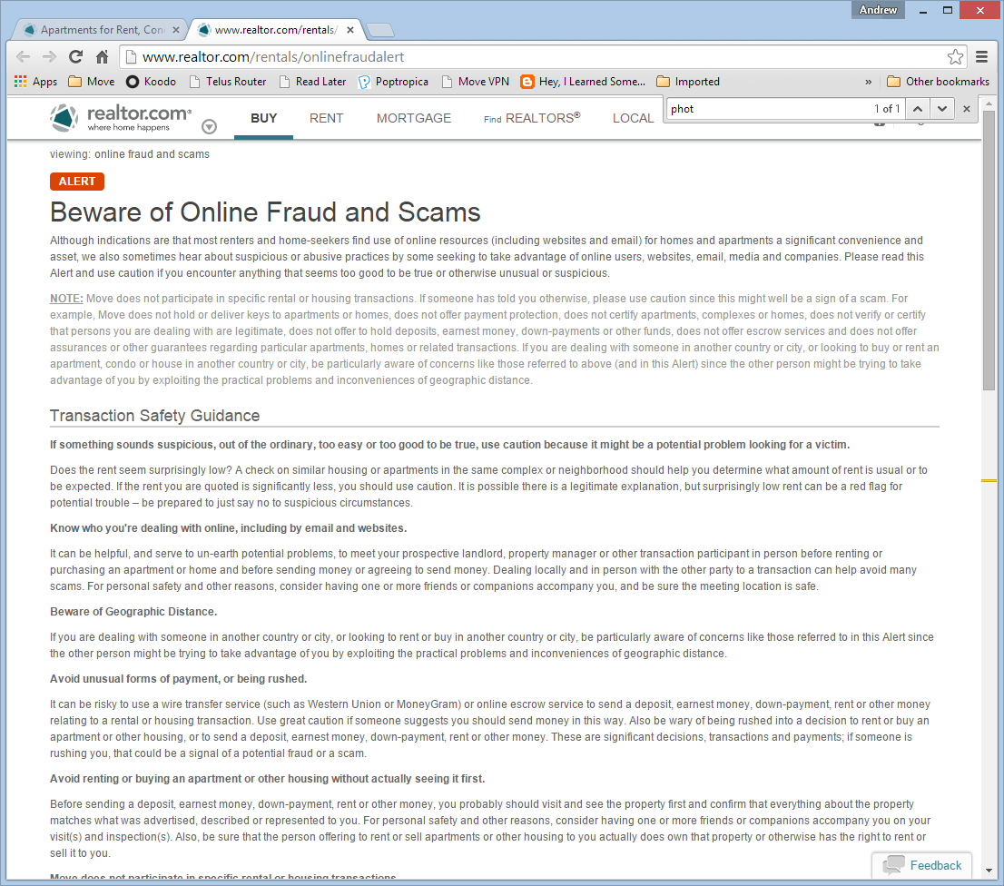

Slide 4
Scams cost Move money
Users lose trust in our site, and stop coming back
Legitimate pay-per-click advertisers don't get as many leads or impressions
Customer support and tech support has to investigate and remove problematic listings
Notes:
Source: Greg Fischer

Slide 5
2 Main Scams:
Brokers publish duplicate listings to gain leads
Other scammers (often foreign) pose as owners or agents and attempt to solicit down payments
Fake listings frequently use photos taken from legitimate listings
Notes:
From Greg Fischer:
- It might make sense to break down scammers into two segments.
A) Real estate brokers: although these aren't actual scams (mostly) this is how brokers make money by posting duplicate listings. In New York this is especially common because there are open listings, which mean that other brokers are free to publish duplicate listings in order to try an gain leads. Also specific to New York, renters often pay a fee to brokers for helping them find an apartment which is normally 12-15 of the annualized rent (+/- $3,000).
B) Other scammers: these are usually foreign (or appear to be foreign) scammers that are attempting to solicit down payments and rent money from users who find a house online that they like. Scammers pose as owners or listing agents in order to gain some trust from the user. Often, they simply steal pictures from an active listing and commonly advertise the property at below market rates in order to gain the highest quantity of leads. It has happened a ton of times, especially if you think about the amount of people with bad credit or working in a tight market that think they have finally found a gem. The scammers can successfully get users to wire down payments and advanced rent without even physically seeing the property.

Slide 6
Not all duplicate photos are scams
Sometimes photos are ‘reused’ for multiple apartments in a building
Multiple listings are not de-duplicated properly
Duplicate images often indicate a data problem

Slide 7
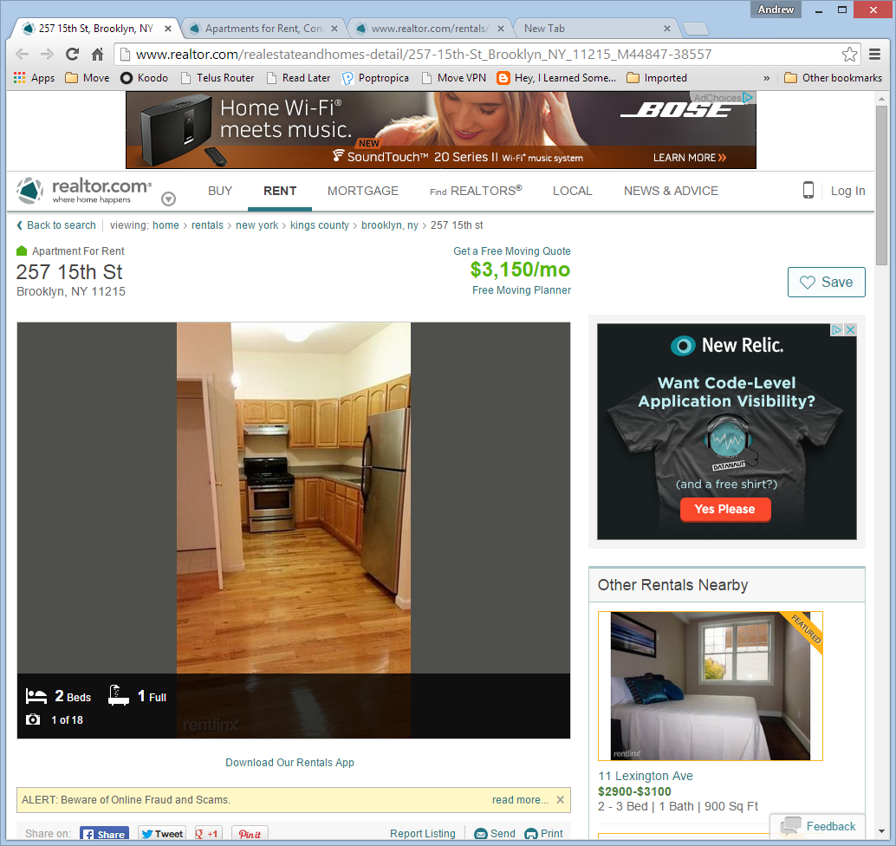
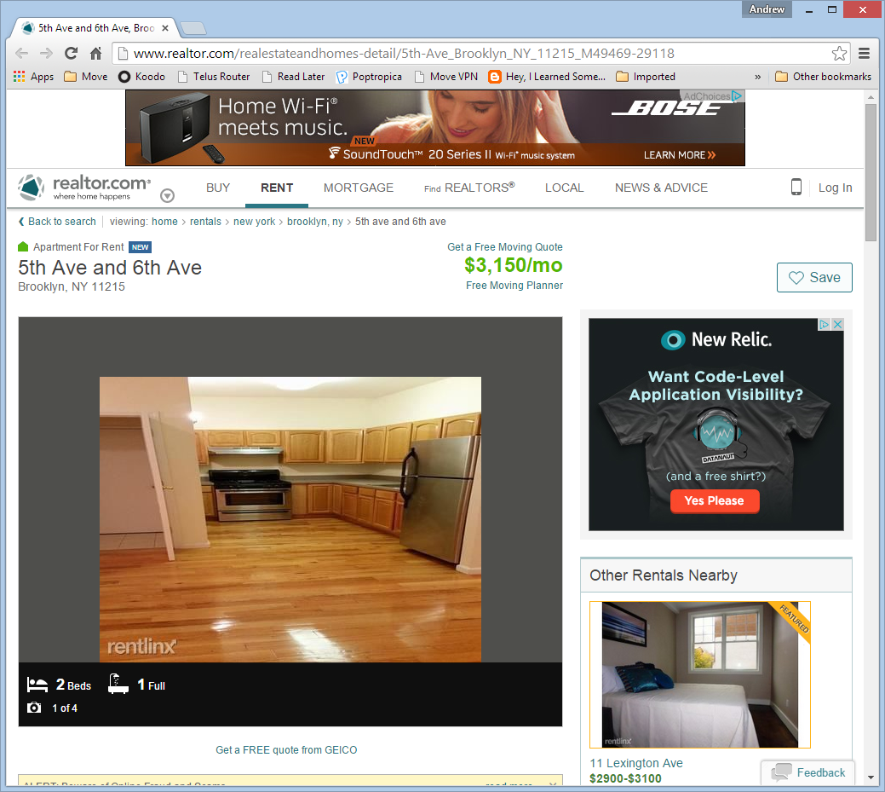
Suspicious

Slide 8
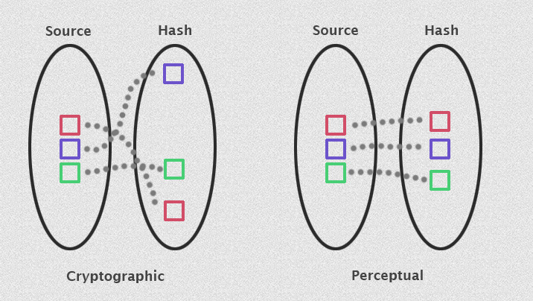
Perceptual Hash
Reduce an image to a single number
Similar images produce similar hashes (unlike cryptographic hash)

Slide 9
Demo

